Slide 1
527 Data Analytics
February 11th, 2016
Chicago Potholes Repair
Hong Zhang

Slide 2
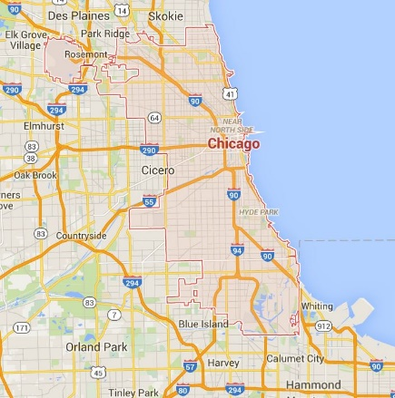
Week 4 Topic: Chicago Pothole Repair Intro/Background
Objectives:
The objective of the report is
To get useful information from the historical data of the potholes repair
To help the management make the decision of the budget and man power
To help the management plan the work schedule for potholes repair
Pothole is a common road defect in Chicago because of cold weather. Repair the potholes is a free service in Chicago. Budget and man power are two important parameters for the financial plan of the city.
In the report, five years of data was collected analyzed. Following information were created for the management:
How much did the city spend on potholes repairing?
How much will we need for coming years?
How many potholes were filled each year?
How long did Chicago Department of Transportation (CDOT) fill a pothole?
How many man power were involved in repairing potholes?

Slide 3
Week 4 Topic: Chicago Pothole Repair Intro/Background
Statistics for the download files:
2011-2015 Chicago Budget Ordinance - Positions and Salaries
Row count for each source file and target dataset:
2011: 8,216 2012: 6,645
2013: 7,215 2014: 7,260
2015: 7,702
Total Target Budget Positions and Salaries Dataset: 37,038
2011-2015 Chicago Budget Ordinance - Appropriations
Row count for each source file and target dataset:
2011: 4,271 2012: 3,894
2013: 3,591 2014: 3,602
2015: 3,707
Total Target Budget Ordinance Dataset: 19,065
Chicago 311 Service Requests - Pot Holes Reported (Note: 311 is a services phone number service system which Chicago residents can call to report street surface potholes. According to 311 service system, CDOT crews repair potholes. )
Total row count included: 390,113
Chicago Performance Metrics – Transportation
Total row count included: 6,997
Chicago 2011-2015 historical weather data from the National Weather Service
Total row count included: 1,826

Slide 4
Week 4 Topic: Chicago Pothole Repair Intro/Background
Data process:
It is assumed Chicago Budget for repairing potholes will all use to repair. We collect this part’s data from the dataset of Chicago Budget Ordinance-Positions and Salaries which presents the labor cost, and the dataset of Chicago Budget of Ordinance-Appropriations which presents the material cost.
During the datasets of Chicago Budget Ordinance-Positions and Salaries from 2011 to 2015, different names were used to name the same department or titles. Hence, we use different filter to get each year’s labor budget for potholes repair.
Because potholes are typically irregularly shaped pavement holes and Chicago uses asphalt to fix potholes, we assume the column of “subsection” contains “Street”, “Alley” , “Pavement”, “Asphalt” or “Pothole” will presents this subsection works for potholes repair. So, there are the filters to get the each year’s labor budget:
In 2011 dataset, subsection = Asphalt
In 2012 dataset, subsection = Street and Alley Repair Unit & Street and Alley Resurfacing Unit
In 2013 dataset, subsection = Asphalt & Street and Alley Repair Unit & Street and Alley Resurfacing Unit
In 2014 dataset, subsection = Street Resurfacing and Repair Unit
In 2015 dataset, subsection = Pothole and Pavement Maintenance
In the datasets of Budget of Ordinance-Appropriations form 2011 to 2015, we assume the column of “Appropriation” is “Maintenance Street Pave” was be used to buy asphalt.

Slide 5
Week 4 Topic: Chicago Pothole Repair Intro/Background
Data process:
Dataset of Chicago 311 Service Requests - Pot Holes Reported:
1) Created Month, Year columns.
2) Excluding Status = completed-dup
3) Excluding Year = 2016
4) Including Most Recent Action = Pothole Patched only.
Dataset of Chicago Performance Metrics – Transportation:
1) Created Month, Year columns.
2) Excluding Year = 2016
3) Including Activity = Alley Pot Hole & Pothole in Street only
4) Create Man Power column
(Note: Man Power = Average Days to Complete Activity × Total Completed Requests)
Dataset of Chicago historical weather data from the National Weather Service:
1) Created Month, Year columns.
2) Create Monthly Average Temperature in Fahrenheit Degree column
3) Including Event = Snow & Fog-Snow & Rain-Snow & Fog-Snow-Thunderstorm & Fog-Rain-Snow
4) Replace Precipitation column to Snow Depth column
(Note: T in this column means trace and we assume the snow depth is 0)

Slide 6
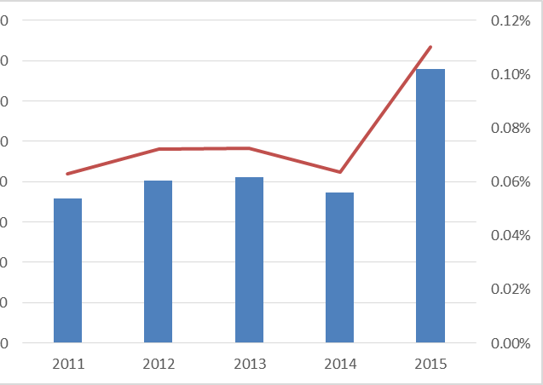
Week 4 Topic: Budget Used
It is assumed the potholer repair budget includes budget of labor and material. The picture shows the budget for potholes repair from 2011 to 2015. Chicago spent $14.96 for each pothole filled (The cost for each pothole filled = average yearly potholes repair budget / average yearly total potholes filled).
The most number is $13,581K in 2015
The least number is $7,161K in 20111
Potholes Repair Budget
The proportion for Potholes Repair Budget in Total Budget
$16,000K
$13,581K
0.11%
$14,000K
$12,000K
$8,070K
0.07%
$8,232K
0.07%
$7,161K
0.06%
$7,466K
0.06%
$10,000K
$8,000K
$6,000K
$4,000K
$2,000K
Year
2011 – 2015 Potholes Repair Budget

Slide 7
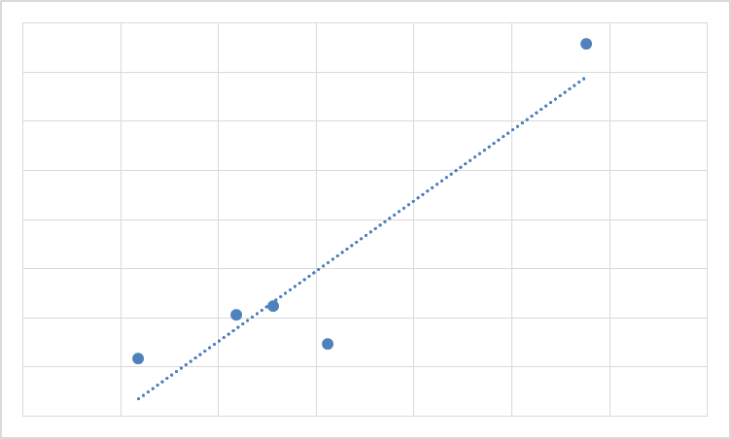
Week 4 Topic: Snow Depth Affects Budget
Year | Potholes Repair Budget (Unit: dollar) | Total Snow Depth (Unit: inch)
2011 | $7,161,432.00 | 2.09
2012 | $8,070,570.00 | 2.59
2013 | $8,232,000.00 | 2.78
2014 | $7,466,010.00 | 3.06
2015 | $13,581,369.00 | 4.38
Analysis results show the correlation coefficient, r between two variables, yearly Potholes Repair Budget and yearly Total Snow Depth is 0.93. It can be concluded the yearly total snow depth is one of the important factor affects the budget of the potholes repair.
A simple linear function is proposed to describe the relationship between total snow depth and yearly potholes repair budget, i.e.,
y = 3 x 10^6x + 374543 R² = 0.859
Y: Budget
X: Snow depth
Assuming the total snow depth in 2016 is 3.5 inches, 2016 potholes repair budget will be $10,874,543.00 based on proposed model.
Budget (K)
$14,000K
$12,000K
$10,000K
$8,000K
$6,000K
1.5
2.5
3.5
4.5
Inch of Snow

Slide 8
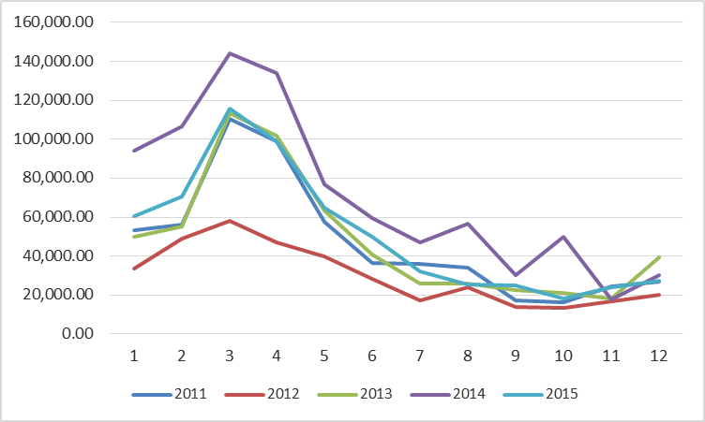
Week 4 Topic: Season Filled Most Potholes
Picture is the total potholes filled each month from 2011 to 2015. The most number appears every March. It follows the coldest months in Chicago.
Potholes
Filled
July
Aug.
Sept.
Oct
Dec.
Month
Jan
Feb
March
April
May
June
July
Nov.
Yearly Total Potholes Filled

Slide 9
Week 4 Topic: Chicago Pothole Repair Analysis
Counting Monthly Average Temperature In Ranges
Because the freezing point of water is 32°F, we choose the range form 10°F to 32°F. Through checking the numbers of monthly average temperature appearing in different range, we can find the coldest year rank.
Range\Year | 2011 | 2012 | 2013 | 2014 | 2015
10ºF -- 20ºF | 0 month appeared | 0 month appeared | 0 month appeared | 2 months appeared | 1 month appeared
21ºF -- 32ºF | 2 months appeared | 1 month appeared | 3 months appeared | 3 months appeared | 1 month appeared
Coldest Year Rank | Year
1 | 2014
2 | 2015
3 | 2013
4 | 2011
5 | 2012
Year | Average Days to Complete Activity
2014 | 39.43
2015 | 22.29
2013 | 21.29 (* Missing 5 months data)
2011 | 16.94
2012 | 8.42
If more cold in that year, the respond time to repair potholes will be longer.

Slide 10
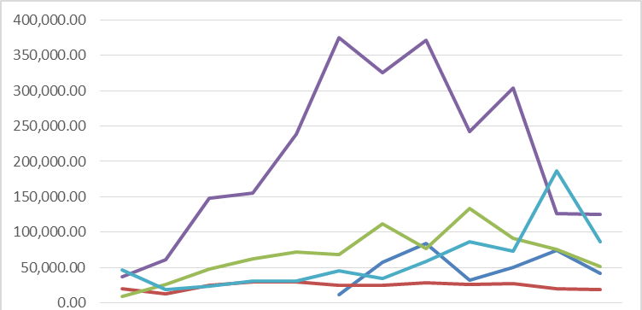
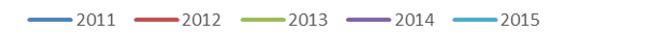
Week 4 Topic: Man Power Analysis
Man Power
Unit: day
Jan
Feb
March
April
May
June
July
Aug.
Sept.
Oct
Nov.
Dec.
Monthly Man Power in 2011 -- 2015
Man Power Investigation
Picture is man power used each month from 2011 to 2015.
Max Man Power: 374,865.37 work days
Min Man Power: 8,732.64 work days
Min Man Power: 8,732.64 work days

Slide 11
Week 4 Topic: Chicago Pothole Repair Summary
The analysis shows:
The average yearly potholes repair budget is $8,902,276.20 and its proportion in total yearly budget is 0.08%. Chicago spends $14.96 for each pothole filled.
The weather is a key factor affects the potholer repair budget. A linear function of yearly total snow depth was proposed to predict yearly budget.
Assuming the total snow depth in 2016 is 3.5 inches, predicted 2016 potholes repair budget is $10,874,543.00 based on the model.
Highest number of filled potholes appears in every March not coldest January and February. More attention is recommended in March to prepare enough material, asphalt.
The weather affects the response time and man power to repair potholes. Longer time and more man power were needed to repair potholes in the colder weather. Analysis shows
Mean monthly man power is 85,363.16 work days. Maximum man power was 374,865.37 work days. Minimum man power was 8,732.64 work days

